Slide 1
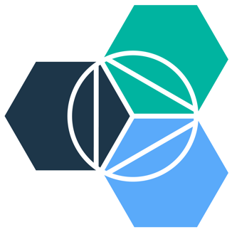
Emerging Technologies
Session #1: Introduction
IBM Bluemix
The Digital Innovation Platform
Sylvain-Roch WILBERT
s_wilbert@fr.ibm.com
Université Paris - Dauphine

Slide 2
Organisation of the sessions
 | Lundi 03 Avril
08h30-10h00 | B 028 | Working with Git and Cloudant
10h15-11h45 | B 028 | Hands-on
 | Mercredi 01 Mars
13h45-15h15 | B 028 | Presentation of the session Installing the virtual image for the session An introduction to Bluemix
15h30-17h00 | B 028 | Creating your Bluemix account Playing with the Bluemix interface Deploying my first application
17h15-18h45 | B 028 | An introduction to nodeJS, cloudfoundry
19h00-20h30 | B 028 | Working with Bluemix on - nodeJS - CloudFoundry
 | Mardi 04 Avril
17h15-18h45 | B 028 | Working with Watson, APIM
19h00-20h30 | B 028 | Hands-on
And a project in order to let you apply the elements shared
Date : 2017 May 2nd
Subject : Implement a web application in bluemix, integrating several services, and enabling REST API to be consumed by a tier application

Slide 3
Emerging technologies What is your definition ?
?

Slide 4



Emerging technologies A continuous journey …. Always accelerating

Slide 5
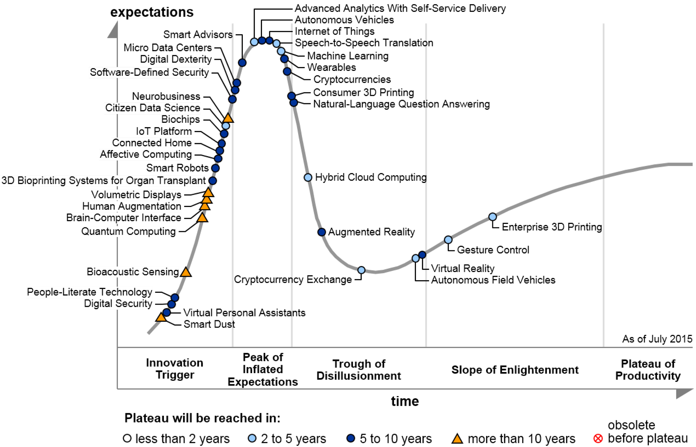
Emerging technologies Gartner Hype Cycle 2015 – Emerging Technologies
Source : Gartner :www.gartner.com/newsroom/id/3114217

Slide 6
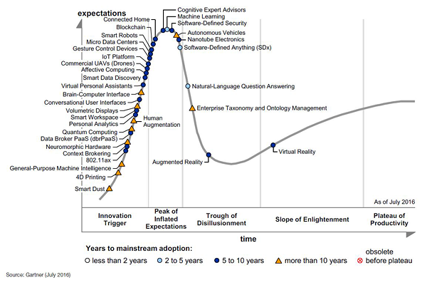
Emerging technologies Gartner Hype Cycle 2016 – Emerging Technologies
Source : Gartner : http://www.gartner.com/newsroom/id/3412017

Slide 7
Emerging technologies An introduction – The App Revolution !
Apps are everywhere
The quantity and usefulness of web and mobile apps has led to an “app revolution” among consumers and businesses alike.
Experience matters
Customers and employees now expect a delightful and seamless experience across all interactions with a business.
Cloud makes it possible
Apps today can be stitched together quickly with pre-built assets. Cloud makes the API economy possible.

Slide 8


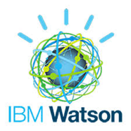




Emerging technologies Our journey
IBM Bluemix
A « Hands-on » experience to deploy in few sessions, a live nodeJS web application on internet with
A noSQL Data Repository
Cognitive capabilities (Real time translation, language detection, Personality profiling)
APIs to be integrated with the external world
Implemented in a seamless Build and Deploy approach
Hosted In the cloud !! (2-clicks provisioning, Scalability…)

Slide 9
SoR, SoE, SoI, Different concerns, different approaches
Support Processes
Tradition Enterprise Systems acting as referential for data and processes
ERP
Directories
…
Remark : Sometimes called System of Reference
System of Record
System of Insight
System of Engagement
Support to Decision Making
Integrates data in the SoE, SoR
Finds new relationships and patterns by:
- analyzing historical data,
- assessing current situation,
- applying business rules,
- predicting outcomes
- proposing the next best action.
Touches People
deliver apps and products directly in the context of the daily lives
- mobile,
- social,
- cloud …..

Slide 10
Emerging technologies An introduction
Applications are everywhere !
New ways of interacting between client and providers: Web application, Mobile Application,Wearable, IoT
New ways of interacting between applications : The API Economy
New domains : Cognitive computing, Big Data
New ways of implementing : Development to Operation cycle, Agility, Velocity, FailFast !
Application Design and Delivery has been reshaped : It is about speed and choice ! :
Self Service tools to address the E2E design, implementation, and run

Slide 11























App dev is about speed and choice Developers’ expectations have evolved.
Useful APIs
Seconds to
Deploy
Friction Free
Continuous Integration
Choice of Tools
Failing
Fast
?
Any Language
Focus on Code
Mobile Ready
Notes:
The instant power and speed of cloud has brought about new expectations for building applications on it.
Developers now expect:
To be able to deploy updates to their applications in seconds
To write their code in whichever tool or language they choose
Each has its own distinct “personality” and followings of developers have evolved around each of these
To be able to continually integrate working copies of code into a shared mainline at multiple points during the day
To focus on writing code, not on the administration of servers, virtualization, operating systems, and middleware.
To “fail fast” - or ensure applications fail immediately and visibly to speed debugging and fixes
To integrate useful APIs into their applications - who wants to write code that’s already been written and tested?
To build applications that are mobile ready - as users today expect their experience to be tailored to whatever device they happen to be using.

Slide 12
Timing is critical Today’s apps must keep up with the speed of the app revolution.
Core IT
Customer Managed
Code
Benefits
Fully customizable.
Few limitations.
Necessary for some solutions.
Existing Investments.
Data
Runtime
Middleware
Time Commitment
Weeks to setup and deploy.
Maintenance/upgrades of hardware and software.
OS
Virtualization
Servers
Storage
Networking
Time to initial deployment
~ Weeks
~ Days
~ Minutes
Notes:
Timing is critical if your apps (and the functionality they provide to your employees and/or customers) are to keep up with the new expectations and competition the app revolution has generated.
Let’s see how everything stacks up:
Core IT represents everything you own and manage in your data centers (the full stack pictured here). This is still a critical part of enterprise IT - let’s take a look why it is beneficial and what it takes to manage all of this.
Core IT Benefits
As stable and customizable as the customer wants - the only main limitation is cost.
Necessary for certain solutions (Core IT still has value in many scenarios i.e. transaction processing)
Houses a lot of the investments most companies have already made (customer data, inventory, SAP, you name it).
Core IT Time Commitment
Typically takes weeks to setup an environment and deploy an initial app - customer manages entire stack pictured here
Have to maintain hardware and software as well (think environment uptime, fixes, upgrades). Dedicated staff necessary.
Thus, Core IT doesn’t lend itself to the experimental nature of development in the cloud/app revolution

Slide 13

Timing is critical Today’s apps must keep up with the speed of the app revolution.
Infrastructure as a Service
Customer Managed
Service Provider Managed
Code
Benefits
Most control in the cloud.
Necessary for some solutions
Infrastructure managed by SP.
Data
Runtime
Time Commitment
Minutes to provision VM.
Time to configure software and apps varies.
Maintenance/upgrades of OS, middleware, runtime.
Middleware
OS
Virtualization
Servers
Storage
Networking
IBM SoftLayer
Core IT
Time to initial deployment
~ Weeks
~ Days
~ Minutes
Notes:
Infrastructure as a Service (and specifically IBM’s acquisition of SoftLayer) was the cloud’s initial answer to the need for faster deployments, faster environment setup, etc… by abstracting the infrastructure from the customer.
IaaS Benefits
Networking, Storage, Servers, Virtualization managed by service provider.
Most customizable cloud offering
Solutions where customizability of OS, Middleware, or Runtime needed
IaaS Time Commitment
Customer sets up and manages OS, Middleware, and Runtime - these still take at least a matter of days to setup and reach an initial deployment
Maintenance/upgrades necessary as well

Slide 14

Timing is critical Today’s apps must keep up with the speed of the app revolution.
Platform as a Service
Customer Managed
Service Provider Managed
Code
Benefits
Setup environments and deploy apps very quickly.
Infrastructure and platform managed by Service Provider.
Data
Runtime
Middleware
Time Commitment
Minutes to setup and deploy.
Focus on your apps and their data.
OS
Virtualization
Servers
Storage
Networking
IBM Bluemix
Core IT
IaaS
Time to initial deployment
~ Weeks
~ Days
~ Minutes
Notes:
We’ve realized that, in a large number of use cases, our customers want to move even faster and don’t need to spend the time managing the platform (VM, OS, Middleware, Runtime). IBM’s answer: Bluemix (platform as a service).
PaaS Benefits
Setup your environment and deploy apps quicker than any other offering
Service provider manages the Infrastructure AND the platform
PaaS Time Commitment
Minutes to initial deployment - developer can handle everything on his/her own
Maintenance and upgrades of Platform and Infrastructure handled by service provider

Slide 15








Leverage the power of Bluemix without abandoning what you already use.
Core IT
IaaS
PaaS
IBM Bluemix
Notes:
While timing is critical (what we just discussed), the systems and data you use today can’t be forgotten. That’s why Bluemix simply and securely connects to core IT and even other clouds (leveraging IBM’s proven reputation as a systems integrator).
Hybrid cloud, where Public and Private clouds work together with Core IT investments, is critical to success given the app revolution and the expectations and increased competition it has generated.
Overall, hybrid cloud represents the “New IT…”

Slide 16
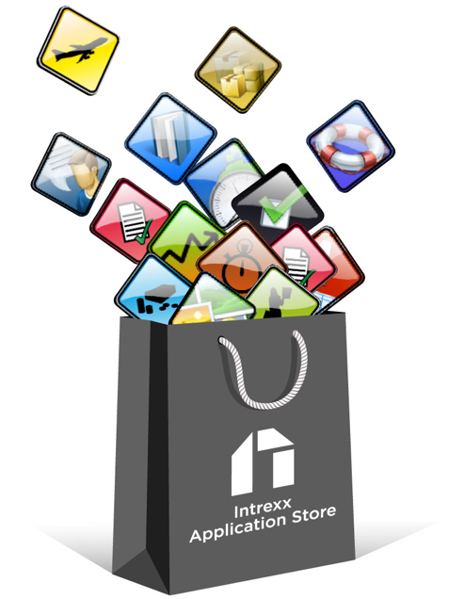
Bluemix, an opportunity for SaaS
SaaS
PaaS
IBM Bluemix
Notes:
Bluemix est pour vous un accélérateur d’opportunités

Slide 17




















The Architecture of IBM Bluemix In a nutshell
DevOps
Tooling
Integration and API Mgmt
Your Own Hosted Apps / Services
Catalog of Services that Extend Apps’ Functionality
+
Web
Data
Mobile
Cognitive
Analytics
IoT
Security
Yours
Flexible Compute Options to Run Apps / Services
Instant Runtimes
+
Containers
+
Virtual Machines
+
Platform Deployment Options that Meet Your Workload Requirements
+
Bluemix
Public
Bluemix
Dedicated
Bluemix
Local
+
Powered by IBM SoftLayer
In Your Data Center
Notes:
Bluemix is built on top of IBM’s infrastructure as a service offering - SoftLayer. It embraces Cloud Foundry as an open source platform as a service and extends it with IBM, third party, and community built services.
Explain Diagram (verbs in blue - please use this terminology)
Start by Pushing your code through Cloud Foundry
Cloud Foundry interprets which language you’ve used and associates your code to the appropriate runtime - now you have a working app (layer above runtimes).
Your app can
Pull prebuilt services (IBM, 3rd party, or community built) in from the marketplace and utilize their functionality
Connect to traditional IT - aka “Your Systems” with a secure connector
Connect to other clouds that you utilize with a secure connector
All of this sits on infrastructure (networking, storage, servers) hosted by IBM Softlayer (IBM’s IaaS cloud offering)
Finally - when your app is built and ready to go, it can be accessed by anything with a web browser and a connection to the internet, a smartphone app (via the Bluemix SDK) to utilize backend services, or another type of app or system (via an API you create).

Slide 18
Our tools
https://ibm.box.com/v/DauphineEmergingTechnologies
A set of PowerPoint presentations
A personal Bluemix account.
A VirtualBox image (Ubuntu 16.04) that contains
all the development tools required for the session
Nodejs
Cloud Foundry Command Line Interface
git
Atom
SoapUI
A web browser
The first steps of the implementation of our session
Remark:
VirtualBox needs to be installed if you want to run the image.

Slide 19
Emerging Technologies
Stop Talking…
…Start Playing !
https://console.ng.bluemix.net/

Slide 20
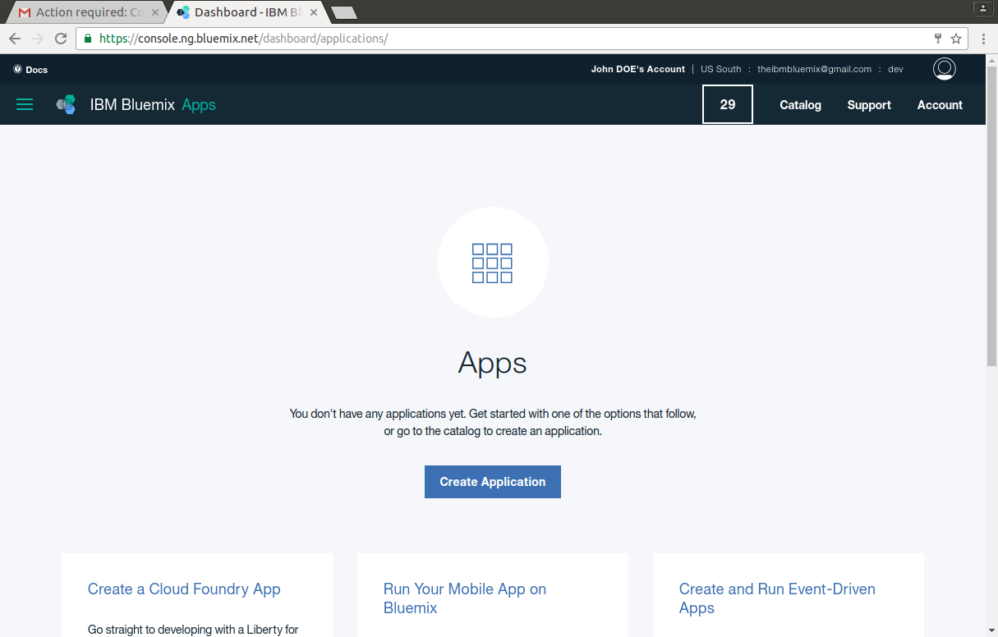
IBM Bluemix Main areas – The dashboard

Slide 21
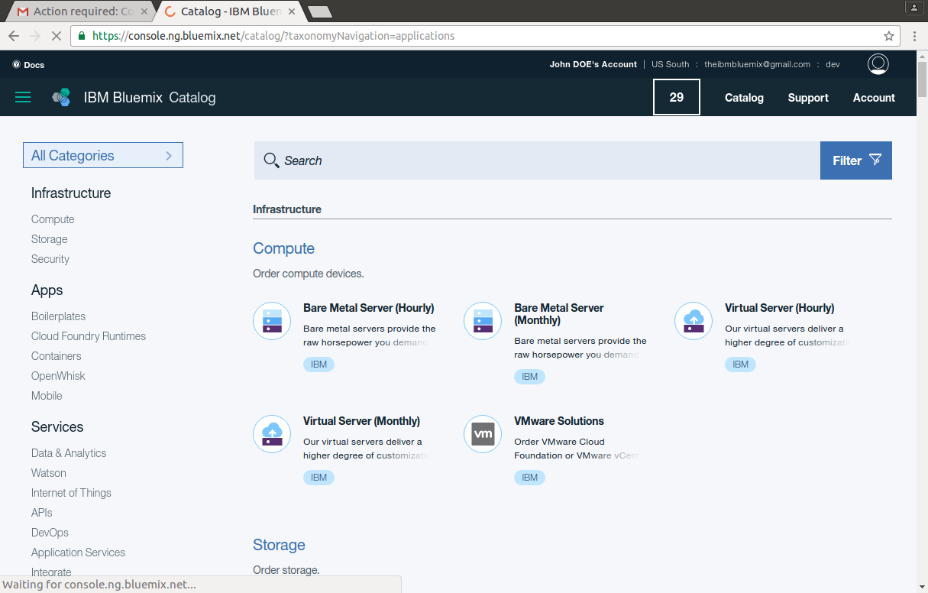
IBM Bluemix Main areas – The catalog

Slide 22
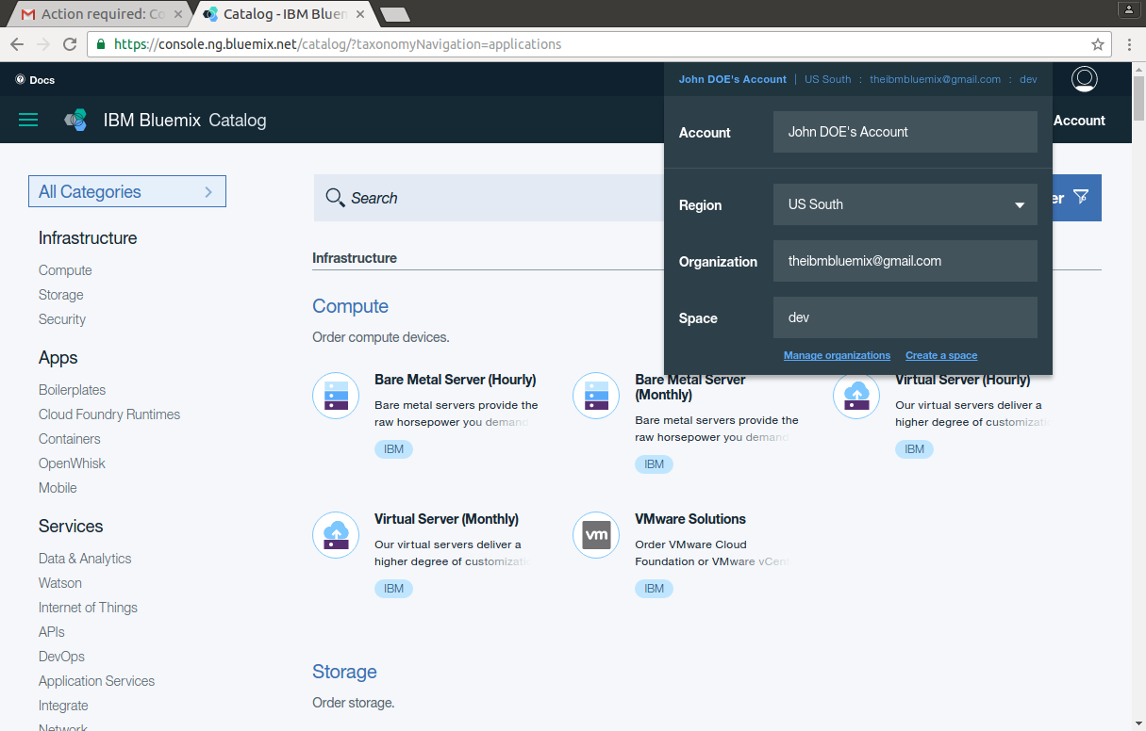
IBM Bluemix Main areas – My Profile

Slide 23
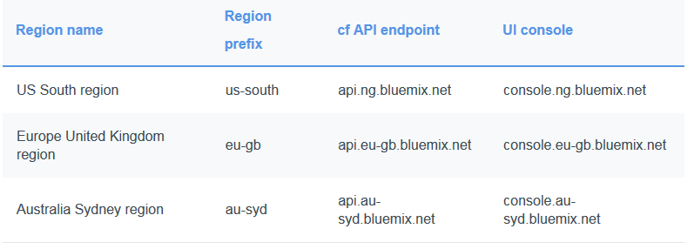
Bluemix Cheat sheet
Bluemix abstracts and hides most of the complexities that are associated with hosting and managing cloud-based apps
Region : A Bluemix region is a defined geographical territory that you can deploy your apps to
Infrastructure
Cloud Foundry: Apps running in the Cloud Foundry infrastructure work with existing Cloud Foundry apps and can bind to any of the services available in the Bluemix Catalog
IBM Containers: With the IBM Containers infrastructure, you can run your web app anywhere that supports container deployment. A container is an object that holds everything that is needed for an app to run
Virtual Machines (BETA): The Bluemix virtual machines infrastructure gives you the ability to create and manage virtual machine groups on the IBM public cloud

Slide 24
Bluemix Cheat sheet
Applications
In Bluemix, an application, or app, represents the artifact that a developer is building.
Mobile apps: Mobile apps run outside of the Bluemix environment and use services that the mobile apps are exposed to. These services typically act in concert, and represent the back-end projection of that app. Bluemix can also host app code that the developer would rather run on a back-end server in a container-based environment.
Web apps: Web apps consist of all the code that is required to be run or referenced at run time. Web apps are uploaded to Bluemix to host the app.
Services
A service is a cloud extension that is hosted by Bluemix. The service provides functionality that is ready-for-use by the app's running code

Slide 25
Bluemix Cheat sheet
Starters
A starter is a template that includes predefined services and app code that is configured with a particular buildpack
Boilerplates: In Bluemix, a boilerplate contains an app and its associated runtime environment and predefined services for a particular domain.
Runtimes:A runtime is the set of resources that is used to run an app.
Buildpacks: A buildpack gathers the runtime and framework dependencies of an app. Then, it packages them with the app into a droplet that can be deployed to the cloud.
Built-in IBM buildpacks. The following list is the built-in buildpacks that are created by IBM.
Liberty for Java
Node.js

